Slide 1
What hypothesis testing is and is not

Slide 2
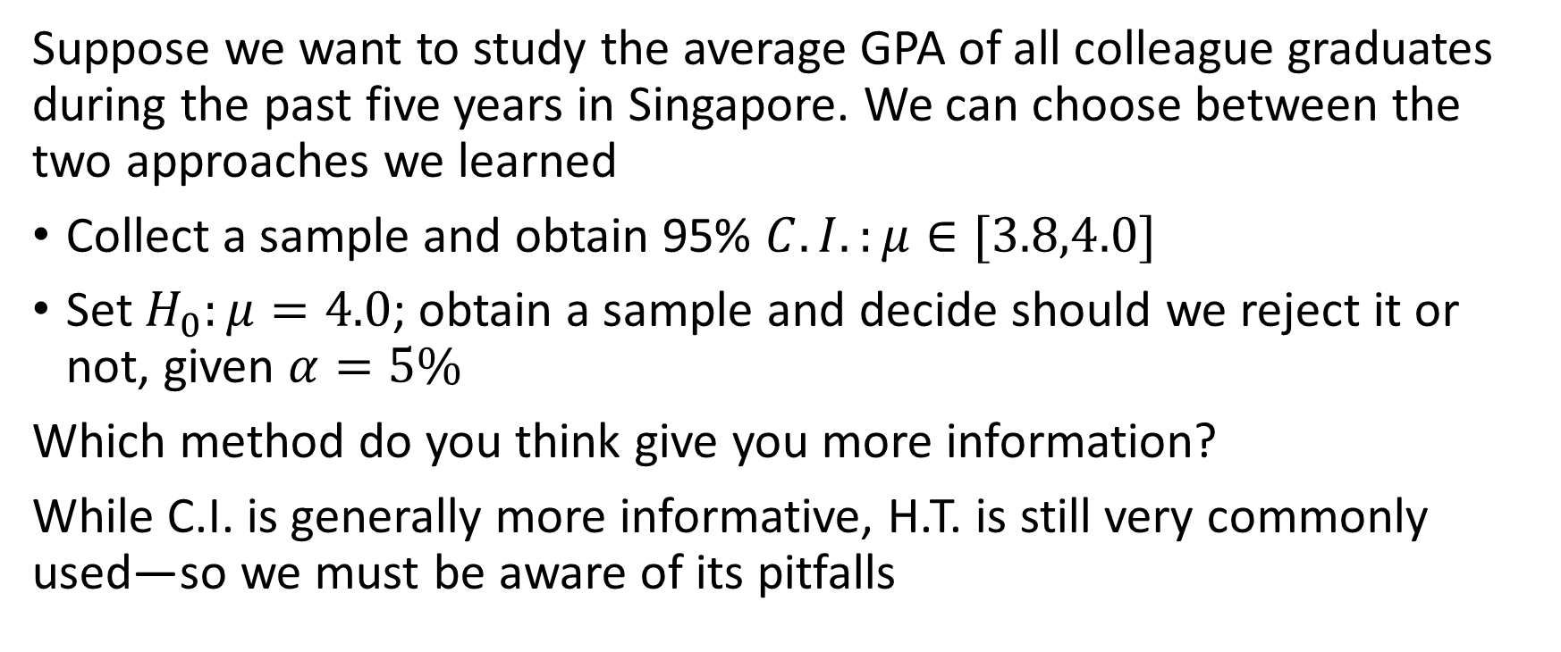
Confidence interval (CI) and hypothesis testing (HT)
Suppose we want to study the average GPA of all colleague graduates during the past five years in Singapore. We can choose between the two approaches we learned
Collect a sample and obtain 95% $C.I.:μ∈[3.8,4.0]$
Set $H_{0}:μ=4.0$; obtain a sample and decide should we reject it or not, given $α=5\%$
Which method do you think give you more information?
While C.I. is generally more informative, H.T. is still very commonly used—so we must be aware of its pitfalls

Slide 3
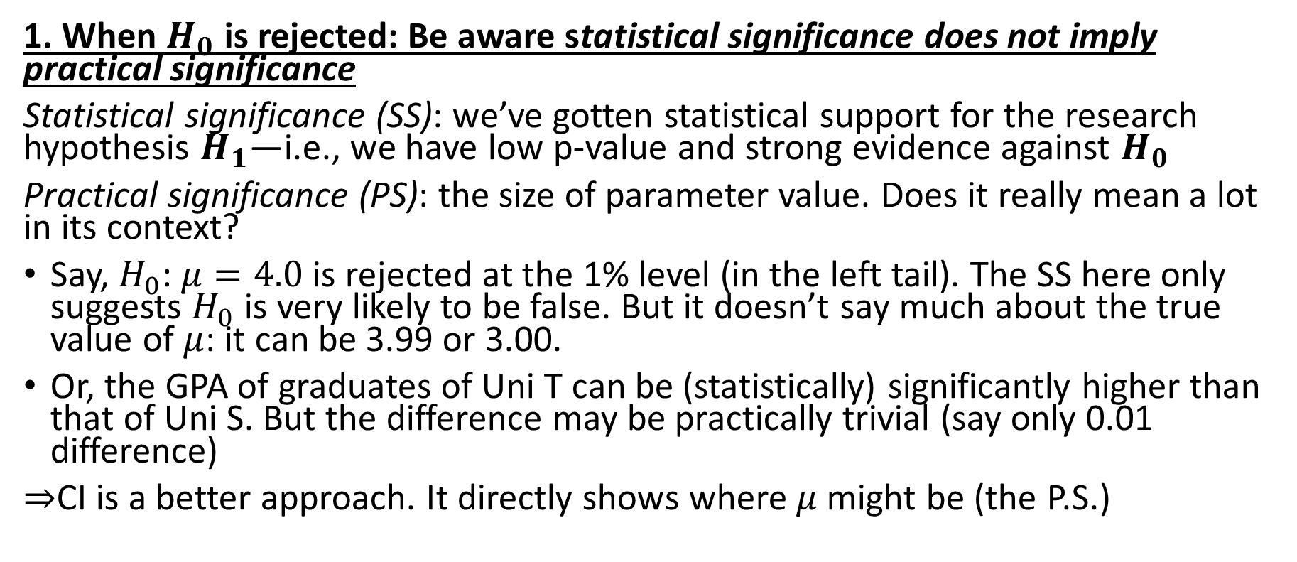
#1 caveat about hypothesis testing
1. When $H_{0}$ is rejected: Be aware statistical significance does not imply practical significance
Statistical significance (SS): we’ve gotten statistical support for the research hypothesis $H_{1}$—i.e., we have low p-value and strong evidence against $H_{0}$
Practical significance (PS): the size of parameter value. Does it really mean a lot in its context?
Say, $H_{0}$: $μ=4.0$ is rejected at the 1% level (in the left tail). The SS here only suggests $H_{0}$ is very likely to be false. But it doesn’t say much about the true value of $μ$: it can be 3.99 or 3.00.
Or, the GPA of graduates of Uni T can be (statistically) significantly higher than that of Uni S. But the difference may be practically trivial (say only 0.01 difference)
$⇒$CI is a better approach. It directly shows where $μ$ might be (the P.S.)

Slide 4
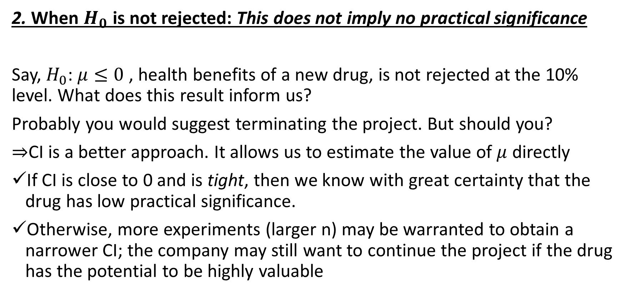
#2 caveat about hypothesis testing
2. When $H_{0}$ is not rejected: This does not imply no practical significance
Say, $H_{0}$: $μ≤0$ , health benefits of a new drug, is not rejected at the 10% level. What does this result inform us?
Probably you would suggest terminating the project. But should you?
$⇒$CI is a better approach. It allows us to estimate the value of $μ$ directly
If CI is close to 0 and is tight, then we know with great certainty that the drug has low practical significance.
Otherwise, more experiments (larger n) may be warranted to obtain a narrower CI; the company may still want to continue the project if the drug has the potential to be highly valuable

